Slide 1

CS 445 NLP
Final Report
Kanat Özgen Erdem Özcan
Mert Coşkuner Yiğit Pekgöz
Jan 2025

Slide 2
Summary
Problem
Resolution
Section
Section
12
Here is the summary of the things done in the scope of the NLP project. Steps involve implementing a simple baseline to check the waters and using a paper from NAACL for improving accuracy further by incorporating changes to the existing architecture.
Increasing the intent accuracy on the NAACL18 paper named Slot-Gated Modeling for Joint Slot Filling and Intent Prediction
⬤ Improved the accuracy from 93.6 to 95.7 with changes to the existing code.
⬤ Used the existing code as a baseline and improved the architecture
⬤ Step 1
Create a baseline for the task using Naive Bayes and TF-IDF embeddings
⬤ Step 2
Using the know-how from the baseline and various resources, improve the accuracy of the paper.

Slide 3
Problems Faced
Section
Section
12
Version Mismatch
The paper that we are implementing was considerably older (from 2018) which required tensorflow version 1.4 and Python 3.5
Data Sparsity
Data is extremely sparse, since the atis_flight label dominates the rest of the classes.
BIO Tagging
BIO tagging helped us to get better attributes, but it became more difficult to work with it.
Lack of Knowledge
We needed to conduct an extensive amount of research to grasp what the paper was actually implementing.

Slide 4
Methodology
Dataset
Paper
Split Ratio
Section
⬤ We used a train/dev/test split of 75/10/15 to train our model.
⬤ This was chosen by the paper authors, and we decided to proceed with this.
⬤ We improved the NAACL18 paper called Slot-Gated Modeling for Joint Slot Filling and Intent Prediction.
⬤ You can access the paper with the following doi:
10.18653/v1/N18-2118
⬤ We used the ATIS dataset, which stands for Airline Travel Information System dataset.
⬤ We chose this particular dataset in order to match up with the existing literature, since there is an abundance of research involving ATIS.

Slide 5
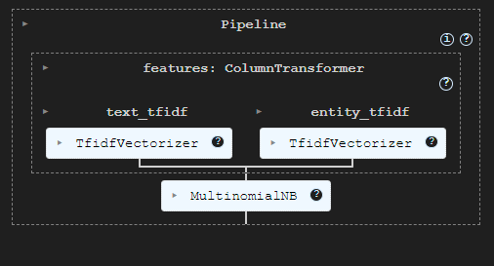
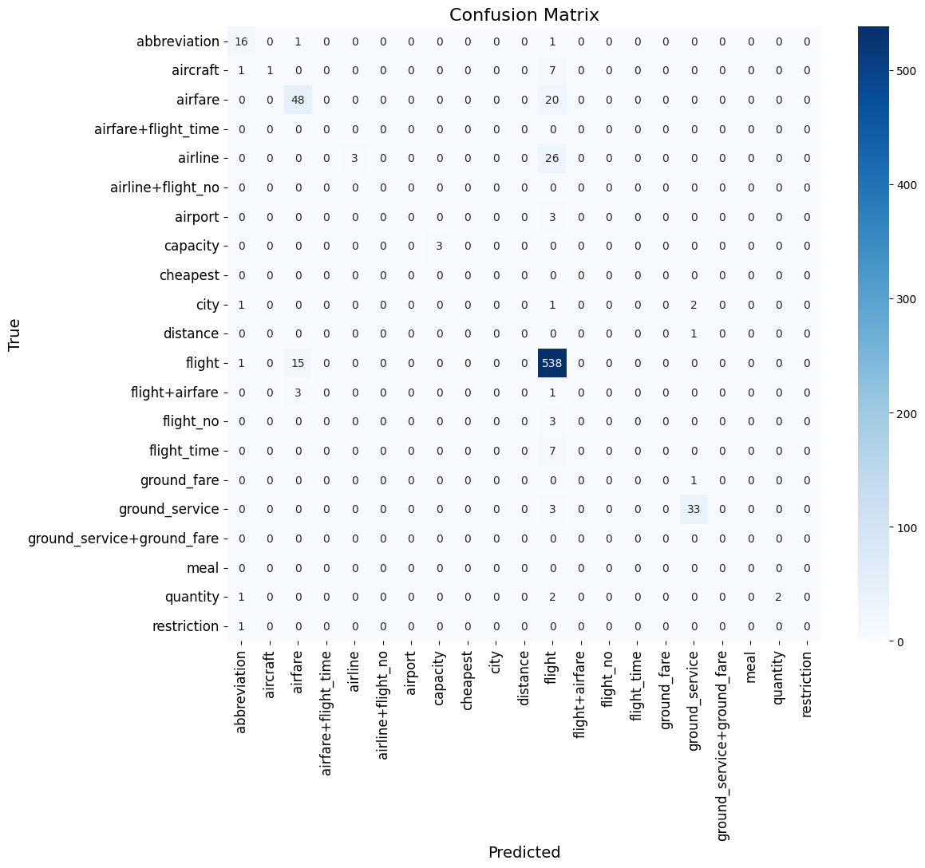
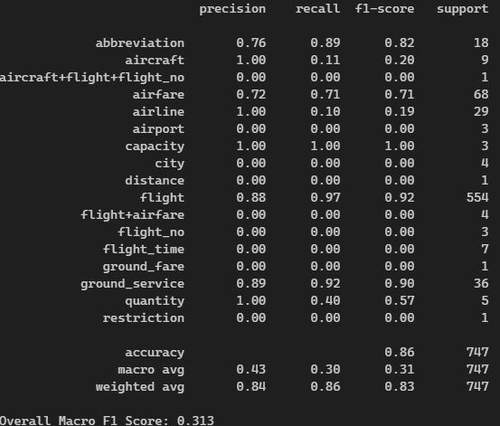
The Baseline
Section

Slide 6
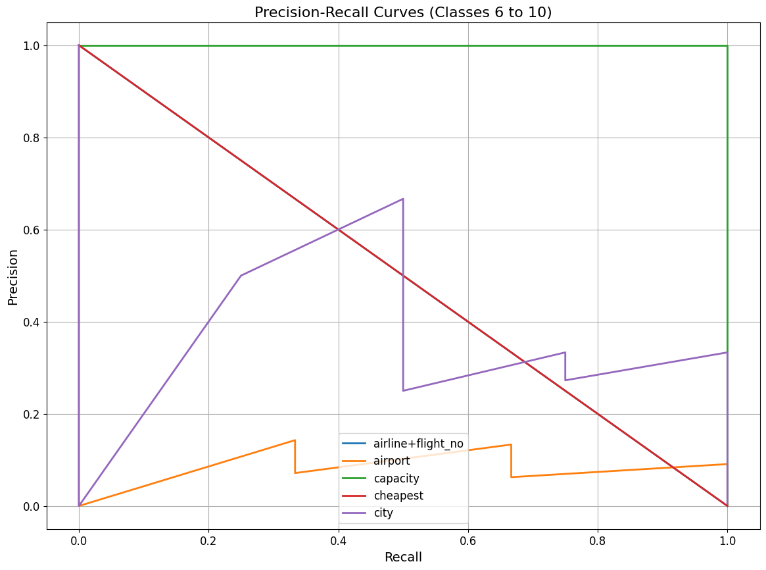
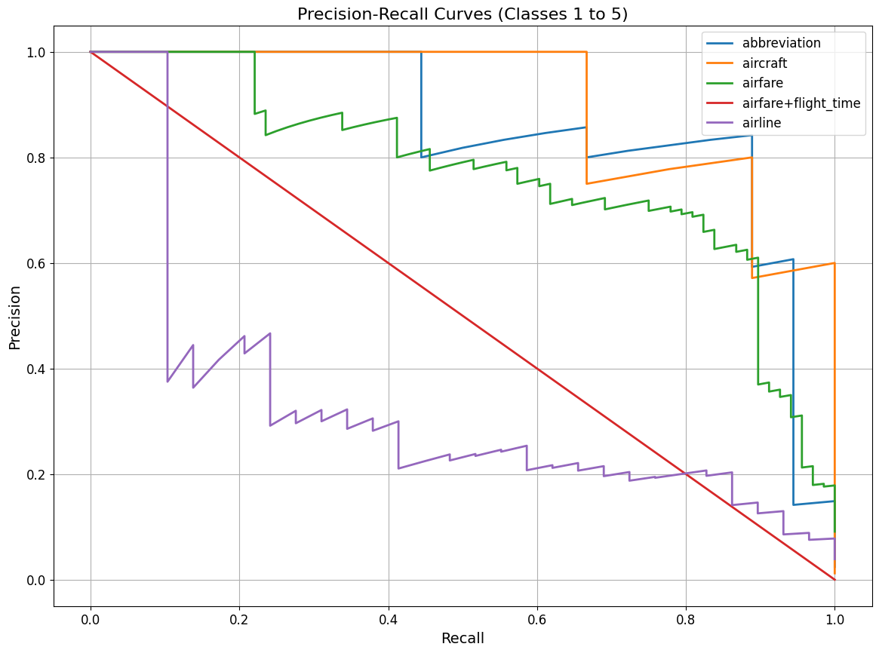
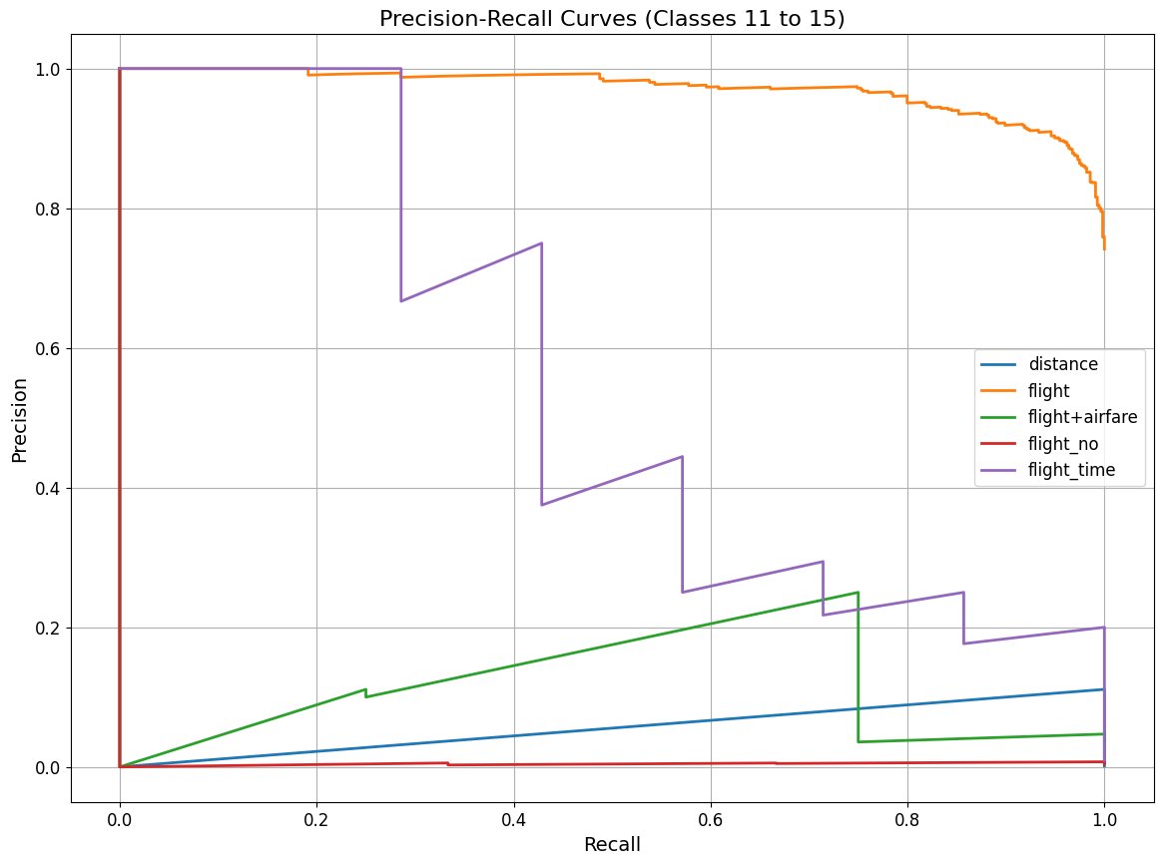
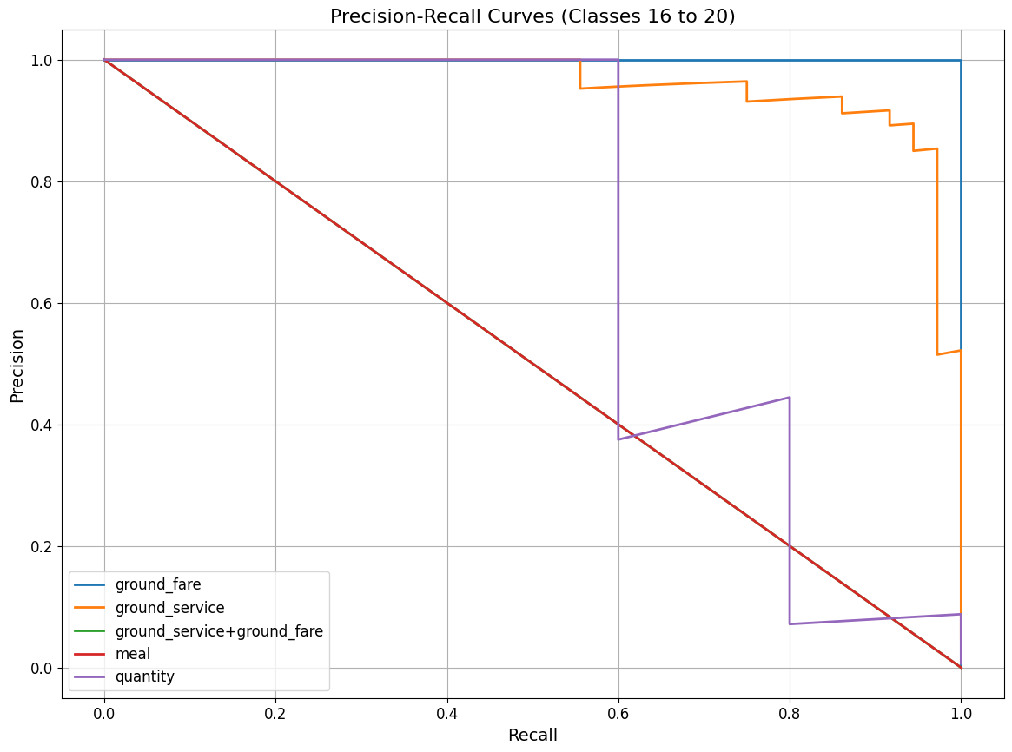
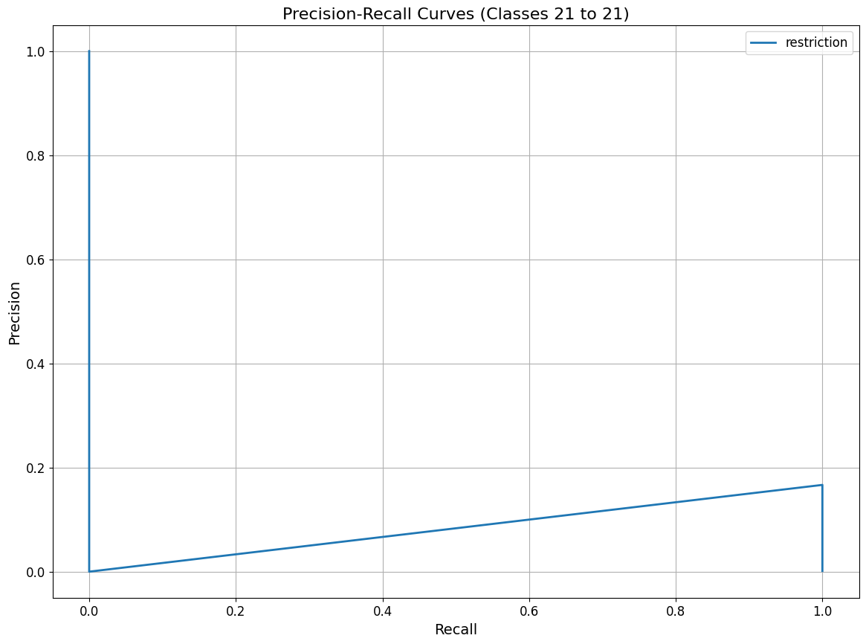
The Baseline contd.
Section

Slide 7
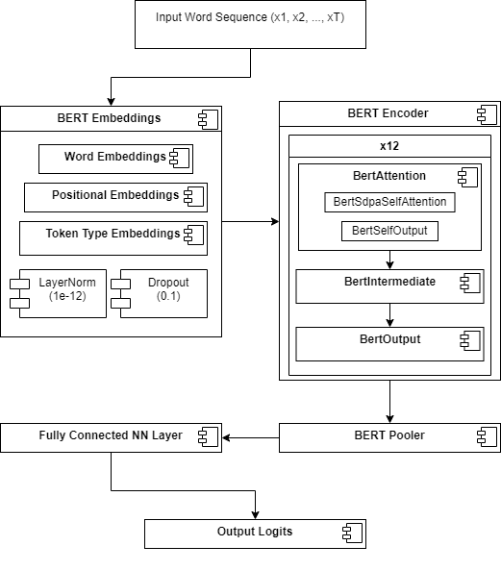
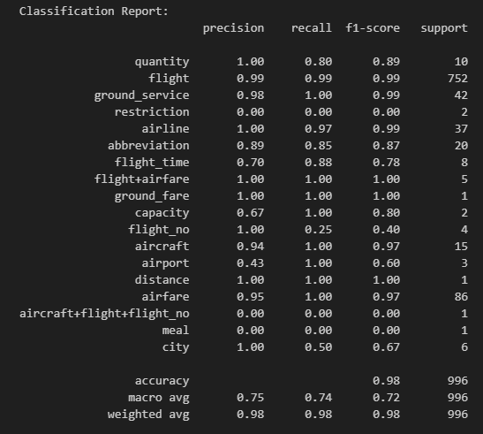
Neural Network with BERT
Section

Slide 8
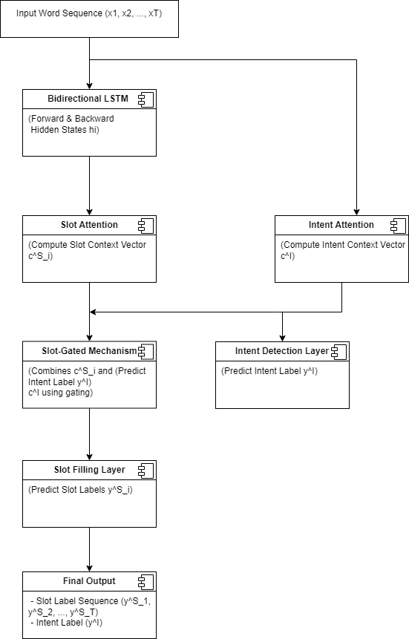
Existing
Architecture
Section

Slide 9

New
Architecture
Section

Slide 10
Results
Section
Section
12
 | Accuracy | Macro F1-Measure
Naive Bayes Baseline | 0.86 | 0.313
NAACL18 Paper | 0.934 | 0.639
Our Proposed Architecture | 0.957 | 0.75

Slide 11
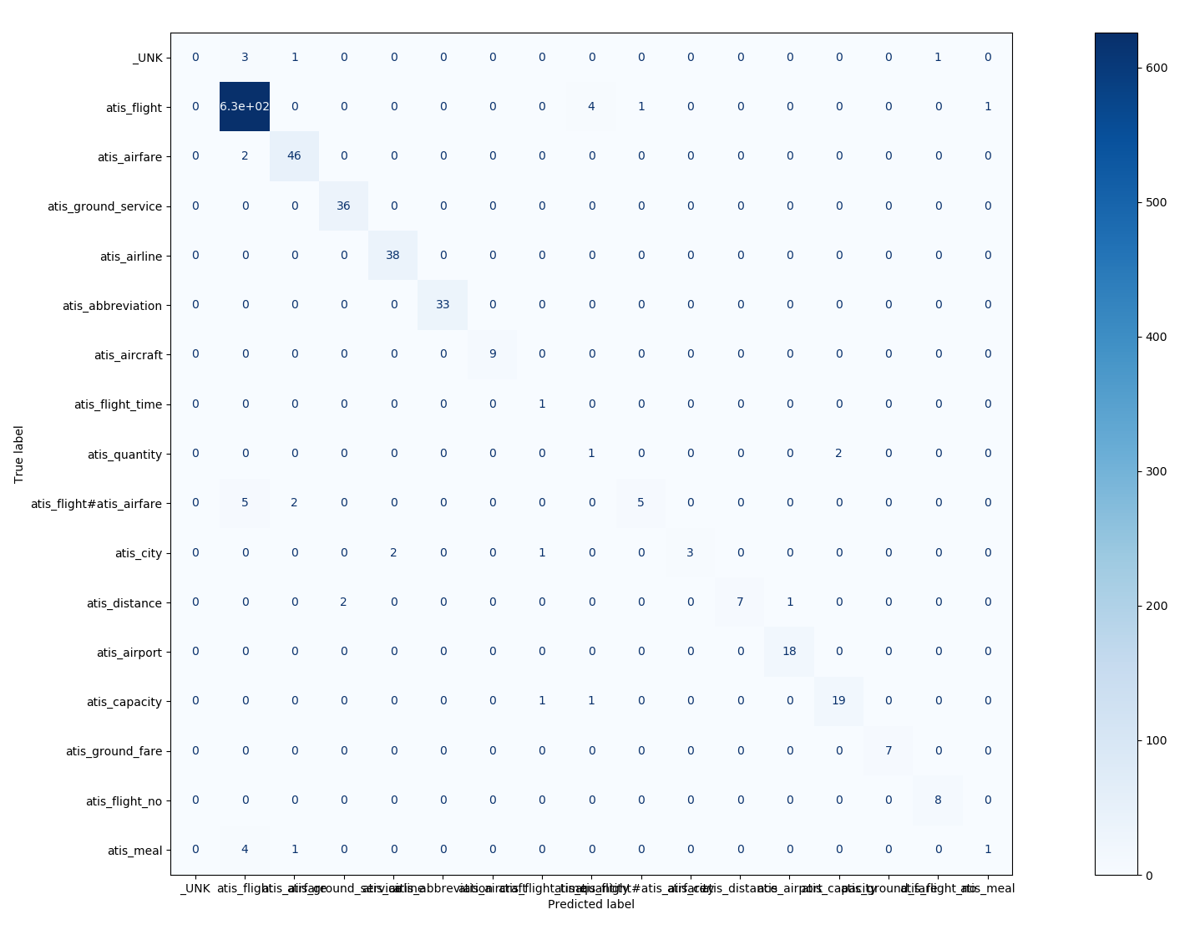
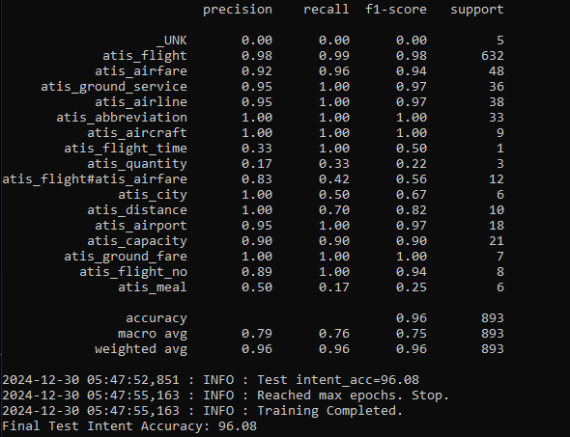
Results contd.
Section
Section
12

Slide 12

Thank
You

